Slide 1
Chapter 5

Slide 2
Outline
Multiprocessor
Structure of Multiprocessor OS
Processor Scheduling
Real Time OS
Real Time Scheduling

Slide 3
MULTI-PROCESSOR SYSTEMS:
In the technological evolution of computer systems, there was a desire of parallel processing with the help of more than one processor.

Slide 4
STRUCTURE OF MULTI-PROCESSOR OSs :
It is obvious that for multiprocessing systems, a different OS is required to cater to the special requirements.
there are three structures for multi-processor OS
1-Separate Kernel Configuration:
2- Master–Slave Configuration
3- Symmetric Configuration

Slide 5
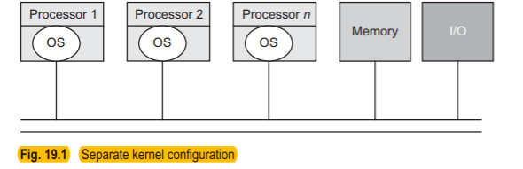
1. Separate Kernel Configuration:
The simplest design of a multi-processor OS is to statically partition the resources in the system into different domains of control and assign these domains to various processors in the system.

Slide 6
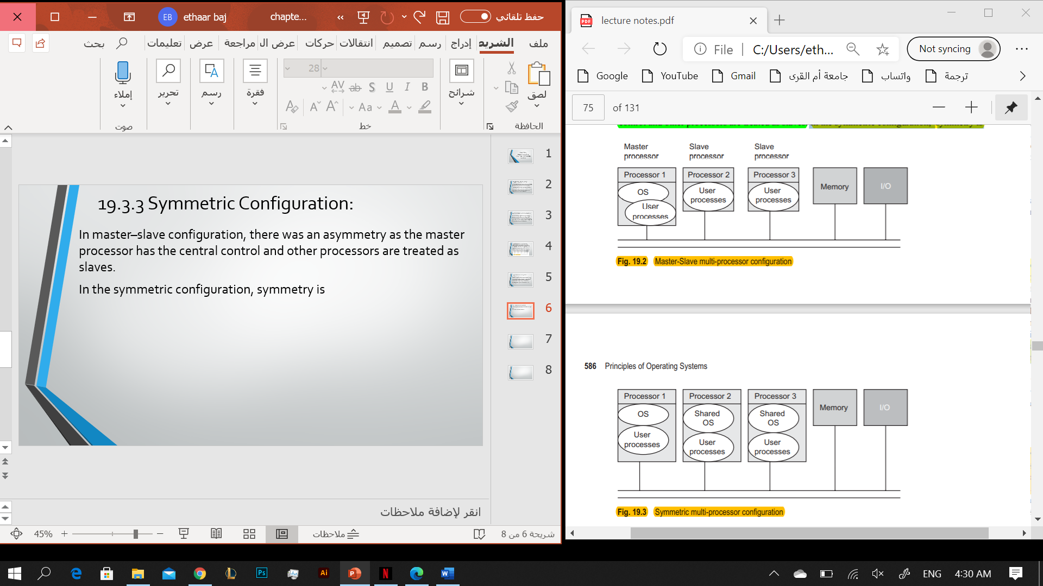
2. Master–Slave Configuration:
This configuration assigns one processor as master and other processors in the system as slaves. The master processor runs the OS and processes while slave processors run the processes only

Slide 7
3. Symmetric Configuration:
Established by same treatment to all the processors. All the processors are able to execute the OS in this configuration. Any processor can access any device and can handle any interrupts generated on it.

Slide 8
PROCESSOR SCHEDULING :
The processor-scheduling algorithm in multi-processor systems is generally divided into the following categories:
1-Job-blind Scheduling Algorithms
schedule processes on any processor without considering any parallel computation of processes or any other preferences.
2- Job-aware Scheduling Algorithms
consider various factors while scheduling the processes or threads. Largely, three factors are considered: parallelism, cache corruption, context-switch time.
3-Time-sharing Scheduling
scheduling considers the independent processes of a program to be executed in parallel and processes are stored with their priorities
4-Affinity-based Scheduling
In this type of scheduling, a process is scheduled to be on the same processor where it last executed.

Slide 9
REAL-TIME SYSTEMS:
A real-time system is one whose logical correctness depends on both the correctness of the outputs and their timeliness. The timeliness factor makes these systems different from other systems.

Slide 10
Characteristics of a Real-time System:
1-High performance.
2-Determinism.
3-Safety and security.
4-Priority-based scheduling.
5-Timing information.

Slide 11
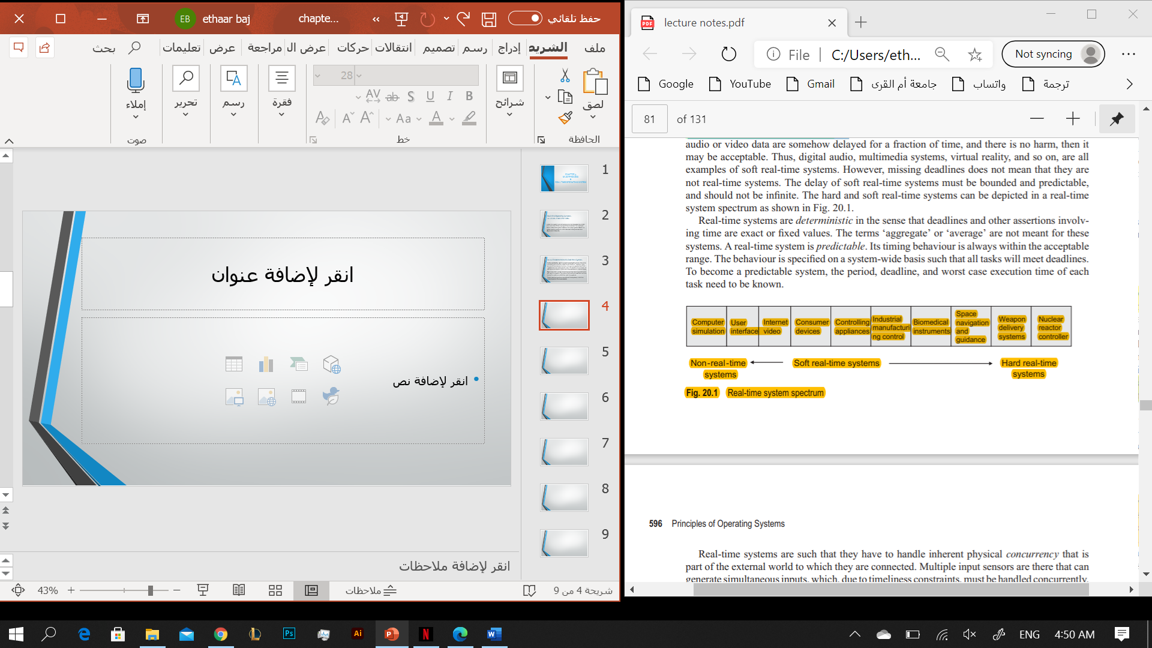
Real-time system spectrum

Slide 12
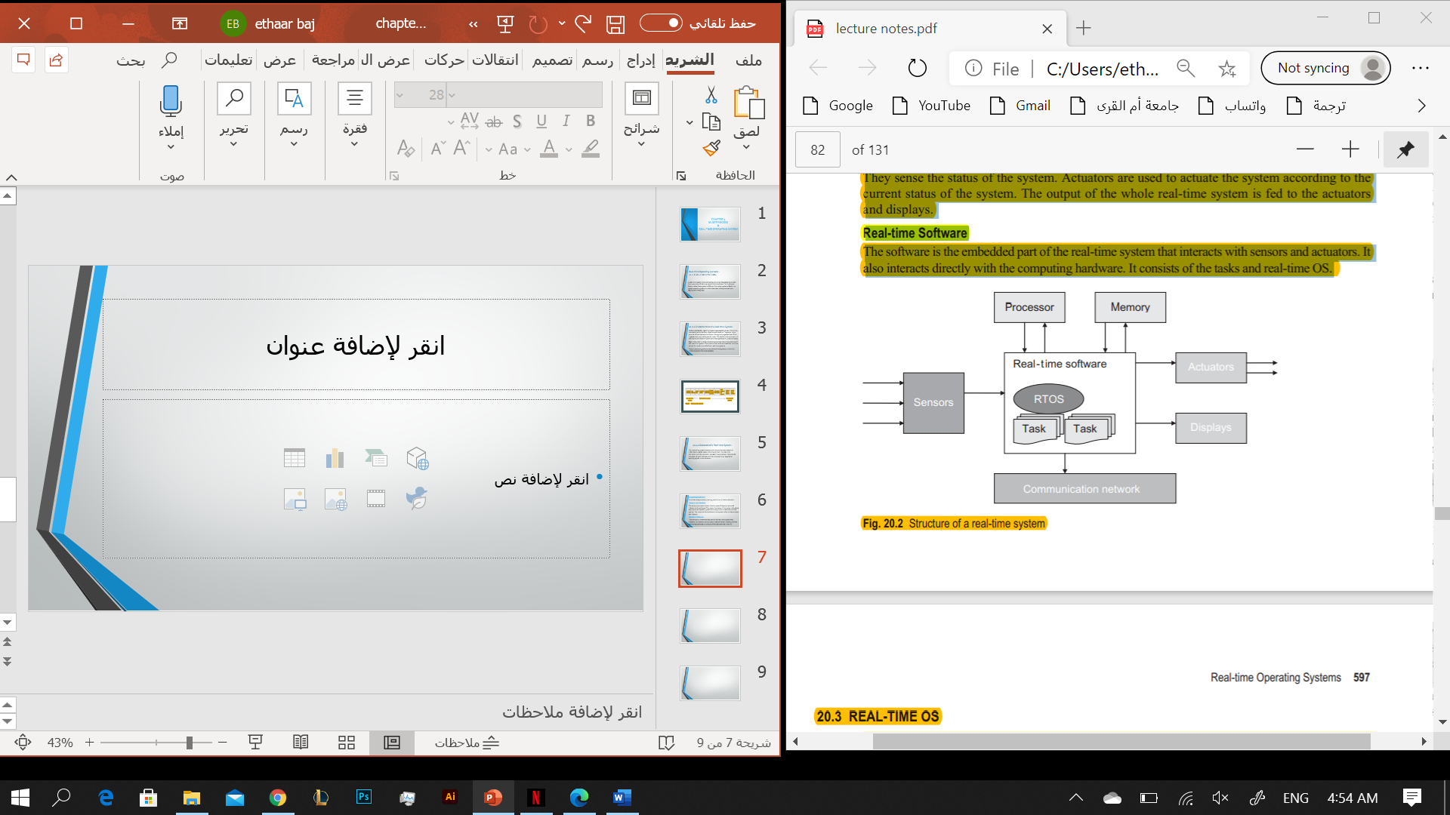
Structure of a Real-time System:
1-Computing Hardware
It includes the processor, memory, and communication networks.
2-Sensors and Actuators
The sensors are used to determine the state of the physical world relevant to the software.
3-Real-time Software
The software is the embedded part of the real-time system that interacts with sensors and actuators.

Slide 13
REAL-TIME OS:
Real-time operating systems (RTOSs) are there to meet the special needs of a real-time system.
Support multiple tasks in a real-time system, the RTOS must be multi-tasking.
Execute a higher-priority task, the scheduler in the RTOS must be able to pre-empt a low priority task.

Slide 14
REAL-TIME SCHEDULING:
• The timing constraints of the system must be met.
• In case of simultaneous access of shared resources and devices, the processes must be prevented.
• The cost of context switches, while pre-empting, must be
reduced.

Slide 15
Rate Monotonic Scheduling Algorithm
Rate monotonic(RM) scheduling algorithm is one of the most widely used real-time scheduling algorithms executed on a uni-processor environment.
The worst case processor utilization for scheduling processes may be given as the following:
e1 /p1 + e2 /p2 + ….. + en /pn ≤ n(2^(1/n) – 1)
n after <= :number of task

Slide 16
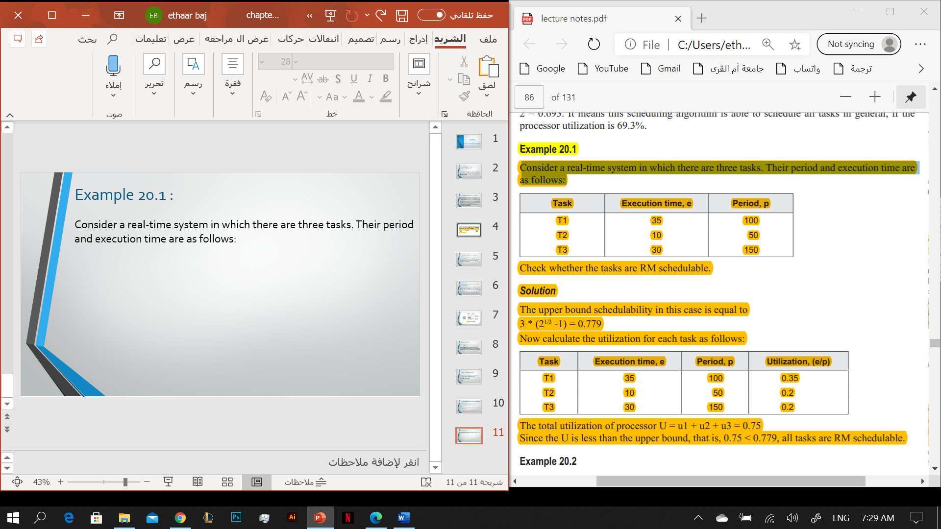
Example RM schedulable
Consider a real-time system in which there are three tasks. Their period and execution time are as follows:

Slide 17
Solution:
N * (2^(1/N) -1), where N is the number of tasks
3 * (2^(1/3) -1) = 0.779
u1= e1/p1 = 35/100 = 0.35
u3= e2/p2 = 10/50 = 0.2
u3= e3/p3 = 30/150 = 0.2
The total utilization of processor U = u1 + u2 + u3 = 0.75
Since the U is less than the upper bound, that is, 0.75 < 0.779, all tasks are RM schedulable.

Slide 18
Earliest Deadline First Scheduling Algorithm:
Earlier deadline first (EDF), also known as least time to go, is a uni-processor priority-driven scheduling algorithm, in which the tasks need not be periodic.
The following are the assumptions while executing this scheduling algorithm:
• There is no such region in any task that is non-pre-emptable.
• The cost incurred in pre-emption is negligible.
• All tasks are independent, that is, there is no precedence constraint among them.

Slide 19
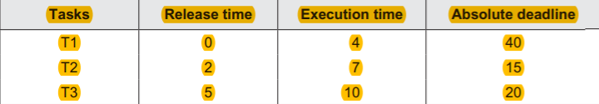
Example EDF scheduling
Consider the following set of tasks in a real-time system:

Slide 20
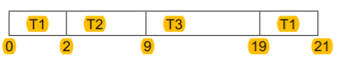
Solution:
T1 is the first task to arrive, so it starts executing. After 2 time units, T2 arrives, whose deadline is shorter than T1. Therefore, it pre-empts T1 and T2 starts executing. After 5 time units, T3 arrives but T2 continues, as absolute deadline of T3 is more than T2. Therefore T2 continues and completes its execution. After this, now there are T1 and T3 tasks that need the processor. Since T3 has a less absolute deadline, it starts executing and completes execution. Finally, T1 resumes and completes its execution. The tasks on the timing diagram are as follows:

